Slide 1
Rhesus isoimmunization

Slide 2
presence of RH antibodies in RH –ve maternal circulation
or development of antibodies against antigen of other individual of the same species
incidence : 45\ 1000 deliveries
10\1000 deliveries
Pathophysiology
Rh antigen is an antigen present on surface of RBCs confer individual specific blood group
IMMUNIZATION
depend on :
amount of blood transfused > 0.25 ml
ABO status of the fetus
ABO compatible : 16%
ABO incompatible : 1-2 %
15% of white
8% black
2% asian

Slide 3
Etiology of immunization
transfusion of improperly cross matched blood
feto-matermal trans placental hemorrhage(FMH OR TPH)
silent
abortion
ectopic
chorionic villus sampling
amniocentesis
APH
external cephalic version
postpartum haemorrhage

Slide 4
immune response
when Rh positive fetal RBCs enter maternal circulation via FMH result in formation or anti-D-antibodies which pass to the fetus through placental circulation and destroy fetal RBCs to produce fetal anemia. the primary initial immune response is by IGM antibodies that’s why first baby rarely affected, secondary immune response is by IGG antibodies which capable of crossing the placenta
FMH in the first and second trimester are minute
In the third trimester as high as 25ml
Kleihauer-Betke test:
Used to detect fetal RBC in maternal circulation
Blood smear is prepared from the mother and treated with acid, adult HB become brown (ghost cell) while fetal RBC persist pink

Slide 5
Pathogenesis of anemia
when maternal antibodies cross placenta, usually in the second or subsequent pregnancies that the fetus affected ,attack RH antigen on fetal RBC ,
non – complement mediated hemolysis occurred
End result is fetal anemia which in turn stimulate extramedullary erythropoeisis in fetal liver and spleen result in hepatospleenomegaly ( hypoproteinaemia , portal hypertension)
Profound anemia result in increase cardiac output but hypoxic heart can no longer sustain and finally result in heart failure( pericardial effusion, pleural effusion, ascitis)
fetal anaemia causes hypoxia , capillary leakage result in pericardial , pleural effusion and ascitis, combination result in hydrops
To compensate for reduced oxygen supply placenta also enlarge placentomegaly

Slide 6
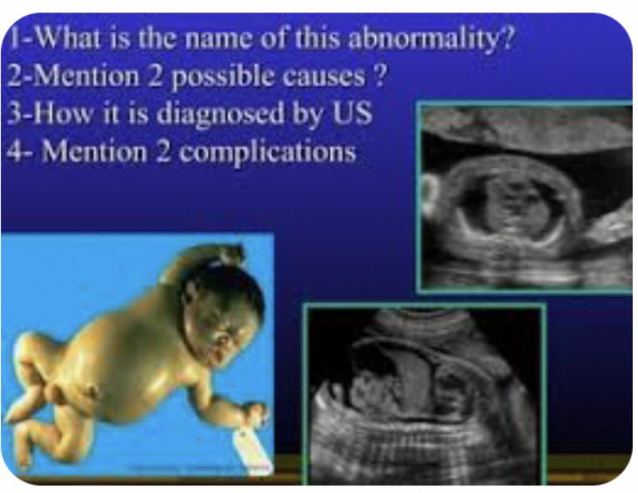

Slide 7
Prevention
administration of RH immunoglobulin
Aim : is to prevent immunization either
- at birth or
- antenatally 28-32weeks to take care of small FMH
- any time pregnant has FMH after 12 weeks
mechanism of action
timing of administration 72hrs
Dose 500iu =100mg
before do estimate of fetal blood in maternal circulation by Kleihaur test under 50 lpf
each 5 RBC equivelent = o.25ml
500iu = 4ml = 80cell in lpf
Prevention of hydrops fetalis:
in patient with previous history
1.o+VE gastric acid resistant capsule
2.bone marrow transplant
3.plasmaphoresis.

Slide 8
during delivery :
hurry removal of placenta
avoid unnecessary spillage of blood in peritoneal cavity
amniocentesis done under USS
Treatment
RH negative non immunized
Determine Rh status of the women ,if negative, determine husband blood group & Rh
Repeat antibodies titer every 4 weeks aim is early detection of isoimmunization treat fetal anemia
Prophylactic anti-D at 28 – 32 weeks??????
anti D to mother with V.B of unknown origin
at delivery : indirect coombs test to the mother and kleihauer test
give anti D within 72 hours of birth if baby Rh positive

Slide 9
Sensitized mother
Mildly affected :
when titer ICT( indirect coombs test) level less than 1 : 16 or 4iu
Repeat antibodies titer every 4 weeks
no invasive fetal evaluation
no prophylactic anti D needed
follow up by USS
delivery at term
moderately or severly affected
if antibodies titer more tha 1:16 dilution
1- Monitor every 2 weeks
2-USS
indicate feature of hydrops
amount of amniotic fluid (polyhydramnias)
fetal spleen and liver size

Slide 10
3.bowel echogenicity
4.cardiac size
5.placental thickness and size( hyperplacentosis or placentomegaly)
3- Doppler USS :
non – invasive method of screening for fetal anemia by assessing blood flow velocity especially in middle cerebral artery MCA-PSV value is according to MOM(multiple of median) if above 1.5 MOM indicate fetal anemia
repeat weekly
4- fetal hematocrite
two invasive method :
direct : direct invasive method of screening for fetal anemia by Cordocentesis to assess blood grouping &Rh
- most effective in management of isoimmunization
direct coombs test, PCV , reticulocyte count, bilirubin level

Slide 11
2. : indirect
spectrophotometry :
(old method )monitor by serial amniocentesis to detect level of bilirubin in the amniotic fluid with help of spectrophotomertry
if antibodies titer increased and MCA-PSV has reached above 1.5 MOM then intrauterine transfusion should be considered or delivery
- repeat intrauterine transfusion every 3 weeks
Delivery at 35 weeks or later

Slide 12
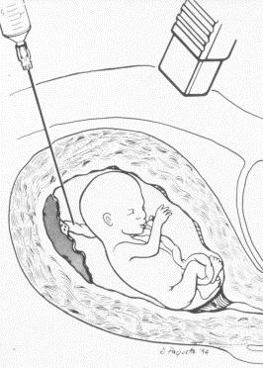
cordocentesis

Slide 13
IUT
most effective step in management of severely isoimmunization
Aim
is to increase haematocrit t0 35-40%
two types of intrauterine transfusion :
Intravascular
safest site is umbilical vein near cord insertion
done only when fetus is hydropic or severely anemic
use fresh O-Ve blood
WBC removed
sterilized by irradiation
PCV = 90%
under continuous fetal heart monitoring
required 3 weekly interval
2. Intraperitoneal transfusion
Used if transfusion needed in early pregnancy or vein difficult to approach

Slide 14
Intravenous immunoglobulin's
High dose of IVIG to the mother as primary therapy
Or fetal IVIG : reduce no. of blood transfusion

